Slide 1



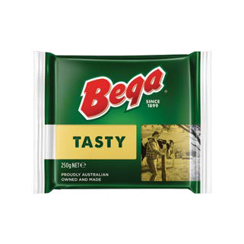
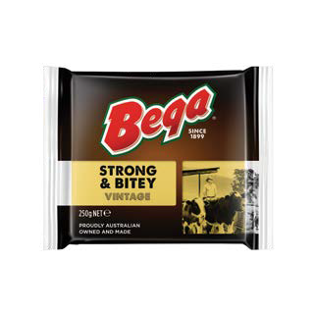
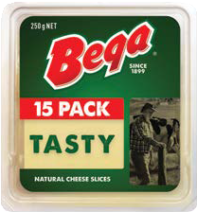
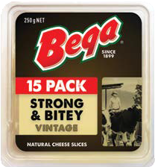
BEGA NATUR AL CHEESE
Bega natural cheese is crafted daily, from milk sourced directly from the finest dairy farming regions in Australia, and transformed into delicious
award-winning cheese using our own special recipes.
As our cheese ages, our expert cheese graders determine batch by batch when the cheese is at its perfect maturity to meet our consumer expectations. Upon selection the cheese is cut, sliced or shredded and packed into convenient sizes ready for use.
Natural Cheddar Blocks
Bega cheese blocks are 100% natural.
A good source of calcium, ideal for a variety of uses, such as snacking, melting or as an ingredient in family favourites.
Halal certified. Suitable for vegetarians.
Bega Natural Blocks
Shelf life: 12 months
Storage: 2–4°C
Packaging: 24 x 250g
Bega Tasty Cheddar is a fuller flavoured semi-hard cheese
with a clean cheddar taste. Perfect for slicing.
Bega Strong & Bitey Vintage is a semi-hard cheese with a rich, sharper, full bodied cheddar taste.
Natural Cheddar Slices
Bega cheese slices are 100% natural cheddar cheese, conveniently pre-sliced in a reclosable fliptop container. In a variety of flavours,
Bega cheese slices are perfect for breakfast, lunch and dinner, on a baguette, sandwich
or burger. Halal certified. Suitable for vegetarians.
Bega Natural Slices
Shelf life: 12 months
Storage: 2–4°C
Packaging: 12 x 250g
Bega Tasty Cheddar is a fuller flavoured semi-hard cheese with a clean cheddar taste. Pre-sliced for your convenience.
Bega Strong & Bitey Vintage is a semi-hard cheese with a rich, sharper, full bodied cheddar taste

Slide 2
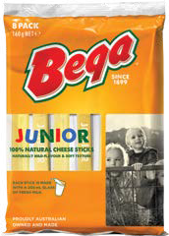


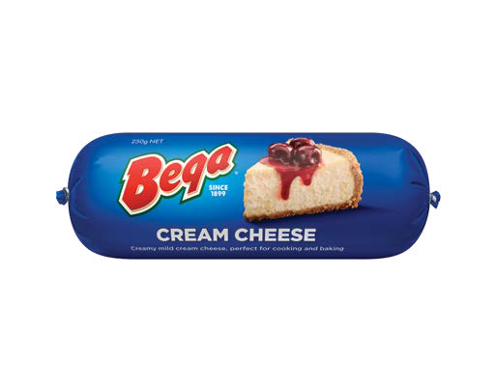
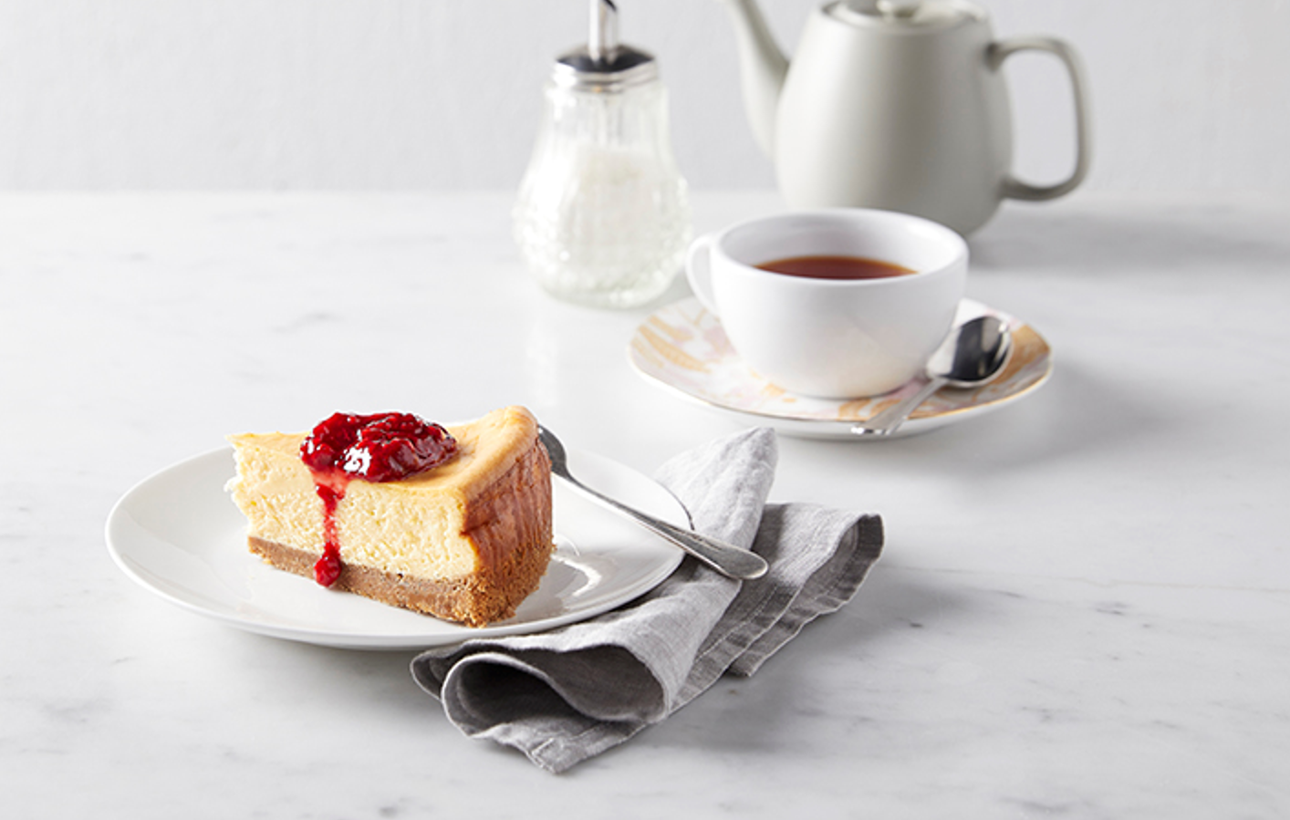
Natural Cheese Snacks
Bega offers a range of conveniently packaged natural cheese snacks for both children and adults. Halal certified. Suitable for vegetarians.
Bega Junior Cheese Sticks
Shelf life: 6 months
Storage: 2–4°C
Packaging: 12 x 160g
Bega Stringers
Shelf life: 6 months
Storage: 2–4°C
Packaging: 12 x 160g, 18 x 80g
Bega Junior Sticks are mild in flavour and smooth in texture. A healthy snacking option for growing children.
Bega Stringers, Made from 100% mozzarella, they contain 37% less fat than regular cheddar cheese. Stringers are the perfect addition for any snacking occasion. Available in Original and Cheddar flavours.
Natural Cream Cheese
Bega cream cheese is available in a creamy full fat variant, and made from high quality ingredients with exceptional functional performance. Our formulation has a clean and fresh taste (no strong cheesy notes) that is perfect to carry milder flavours in baking
and cooking. Halal certified. Suitable for vegetarians.
Bega Cream Cheese Chube
Shelf life: 12 months
Storage: 2–4°C
Packaging: 24 x 250g, 12 x 500g
Bega Cream Cheese “chubes” provides consumers with an easy to use, portioned pack that is ideal for a variety of hot or cold, sweet or savoury applications such as cheesecakes, desserts, dips, toppings and sauces.
WHY CHOOSE BEGA?
Specialist dairy experience since 1899
Consistent quality & reliable functionality for baking, cooking & snacking
Products manufactured to stringent specifications using state of the art manufacturing technology
Proudly Australian made & owned
Bega and the Bega device are trademarks of the Bega Group
Serving Suggestion
Contact Details
Bega Foods International
For sales enquiries contact: toby.nelson@bega.com.au

